Slide 1
Predicting the Output of Unpredictable Microelectronic Circuits
MSML 604: Introduction to Optimization
Group 4 Project
Presented by: Xiaoyan Feng, Sushant Karki, Justin Letwinsky, & Chandramani

Slide 2
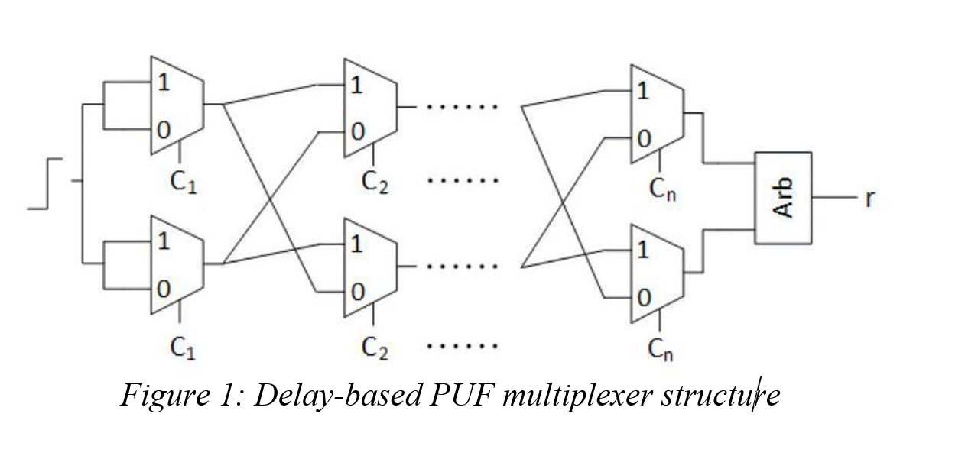
Background
Physical Unclonable Functions (PUFs)
Known for their unclonable, lightweight design
Consists of two delay paths and a comparator
Goal: Predict output of the microelectronic circuit to a target accuracy of 99% or greater

Slide 3
Algorithms Explored
Logistic Regression (from scratch)
Neural Network (using PyTorch)
Support Vector Machines (using Scikit-Learn)
Neural Network (from scratch)

Slide 4
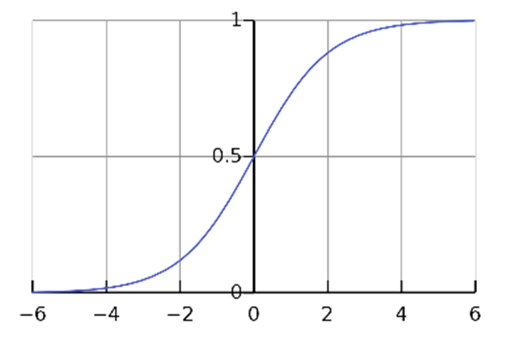
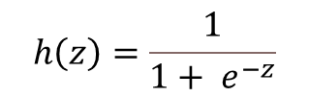
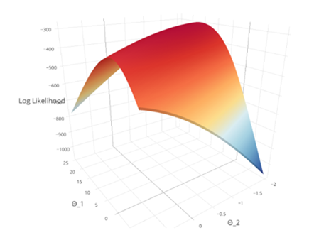
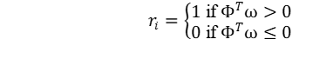
Logistic Regression Formulation
Binary classification with the sigmoid function:
Maximum Log-Likelihood:
Log-Loss Cost Function:

Slide 5
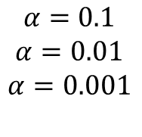
Logistic Regression Numerical Methods
Gradient of the Log Loss Cost Function:
Updating the weights using various hyperparameters:
$$α=0.1$$
$$α=0.01$$
$$α=0.001$$

Slide 6
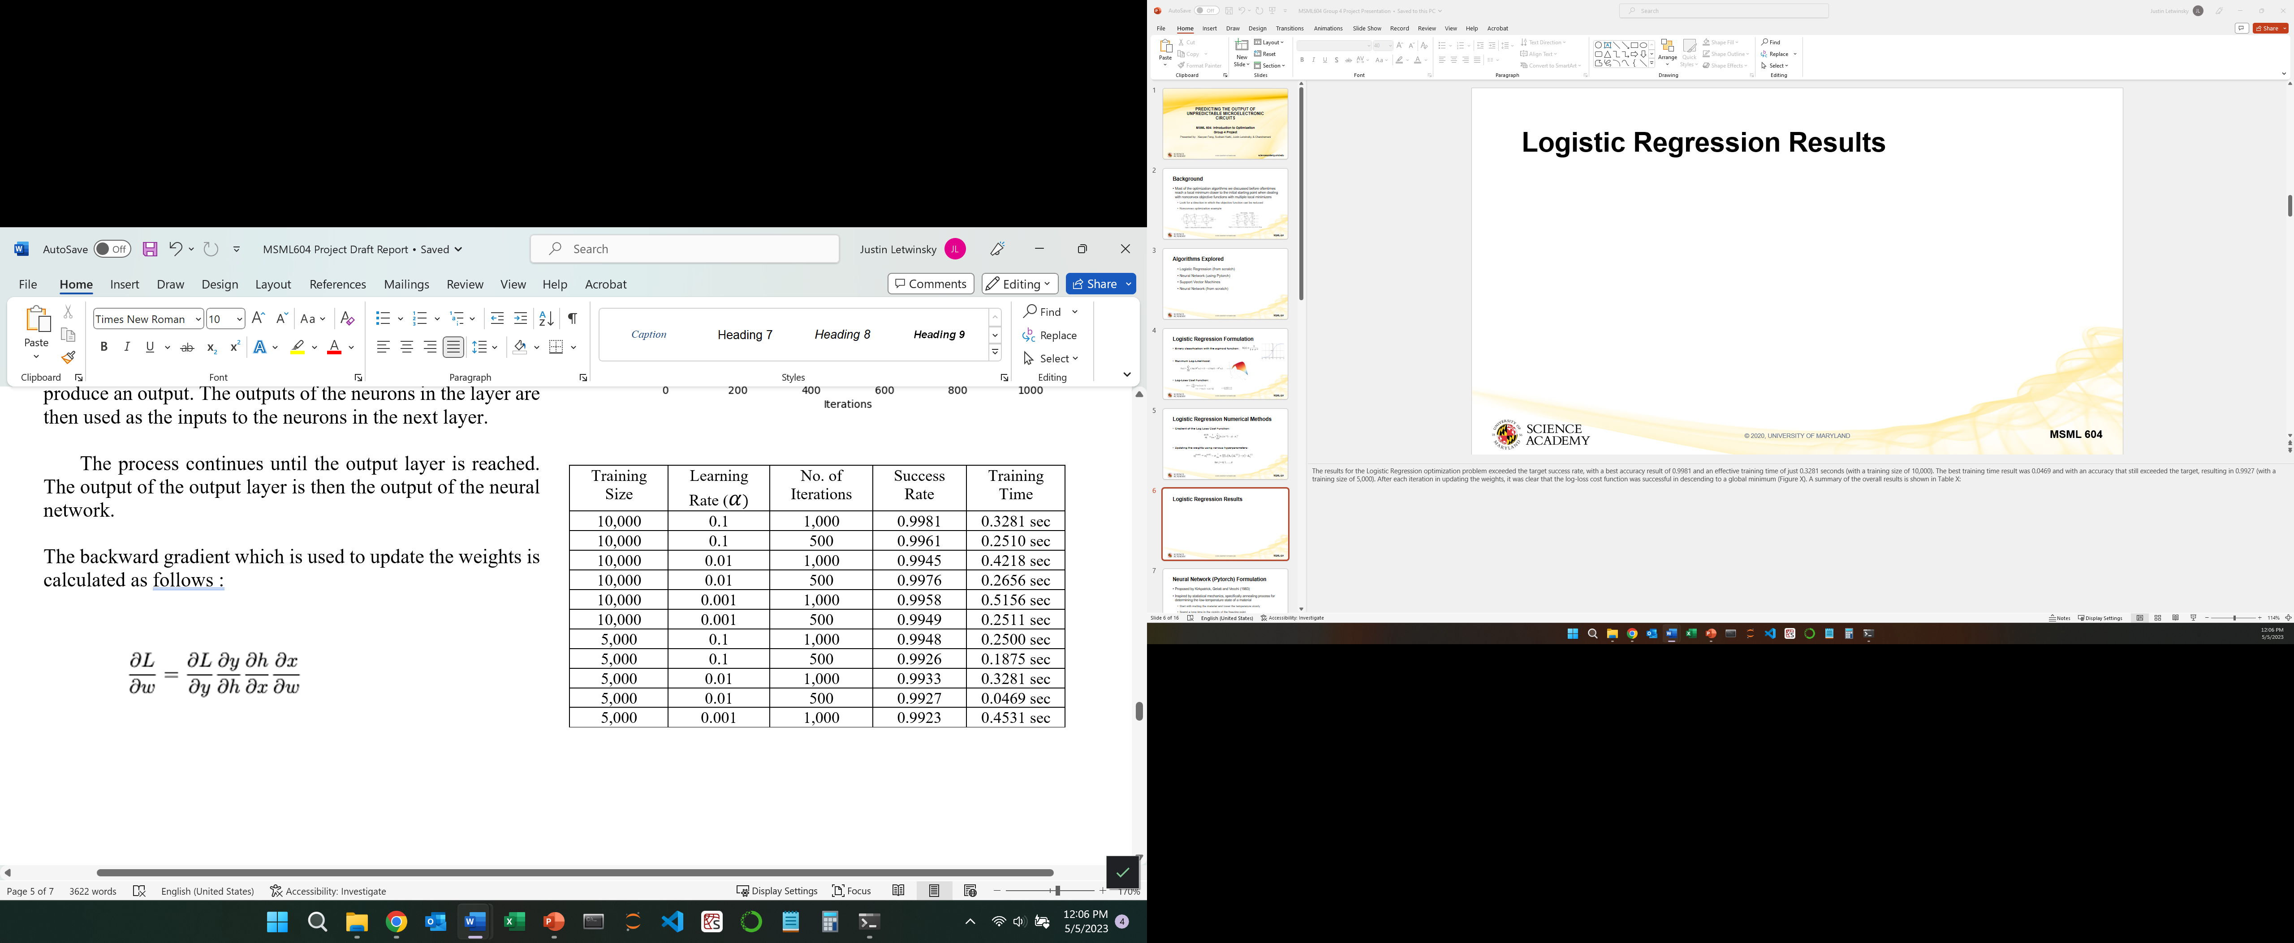
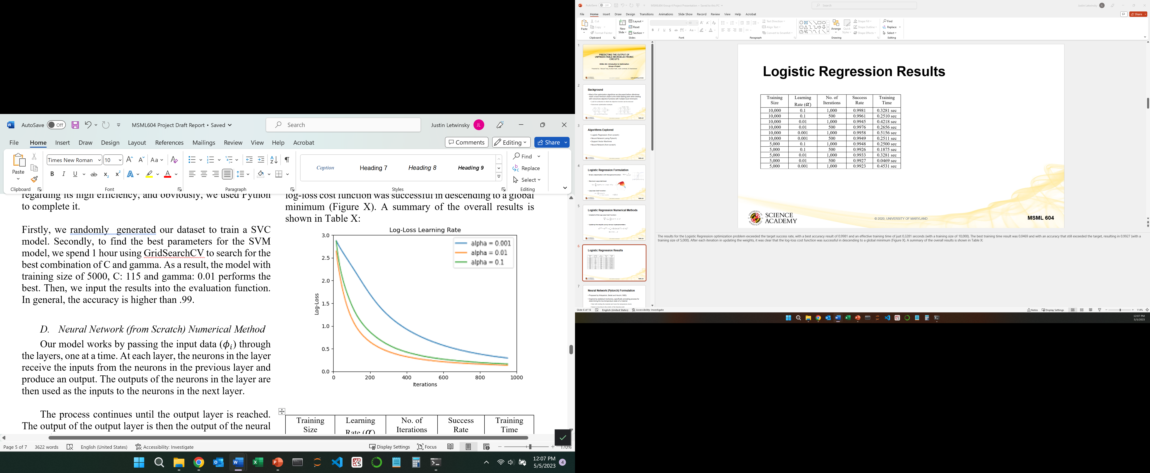
Logistic Regression Results

Slide 7
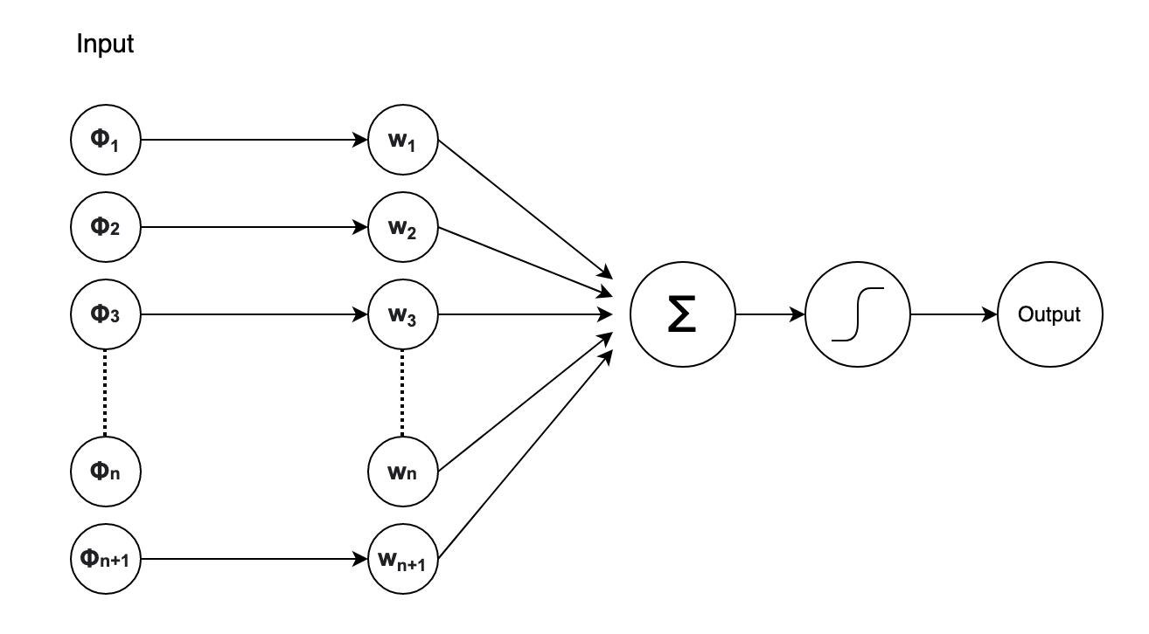
Neural Network (PyTorch) Formulation
Modeled the PUF using a perceptron architecture
Input to the perceptron:
Output from the forward pass:

Slide 8
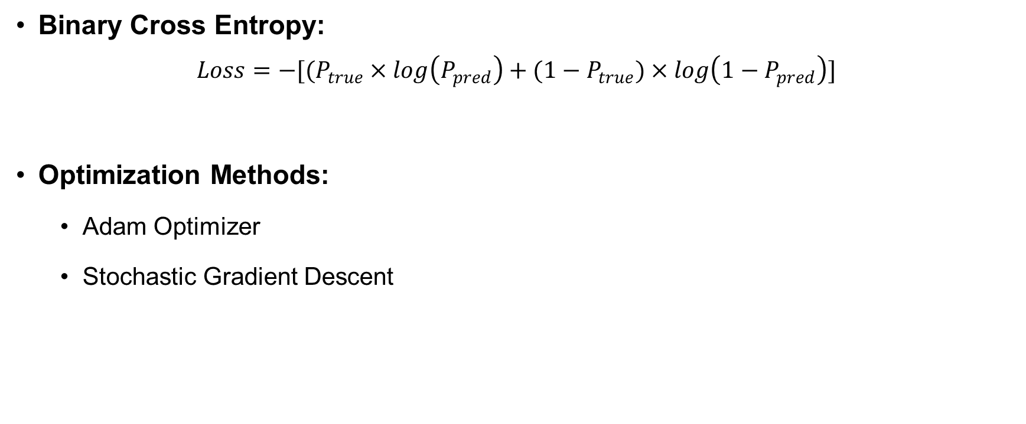
Neural Network (PyTorch) Numerical Methods
Binary Cross Entropy:
$$Loss=−[(P_{true}×log\left(P_{pred}\right)+({1−P}_{true})×log\left({1−P}_{pred}\right)]$$
Optimization Methods:
Adam Optimizer
Stochastic Gradient Descent

Slide 9
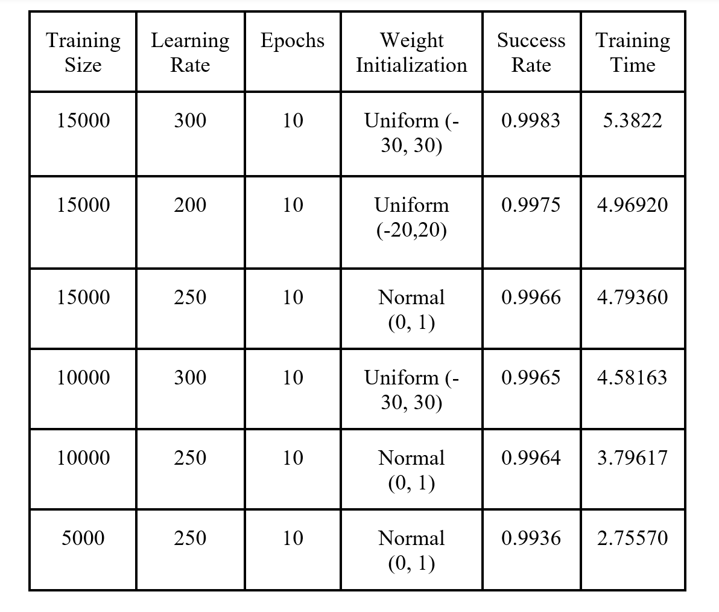
Neural Network (PyTorch) Results

Slide 10
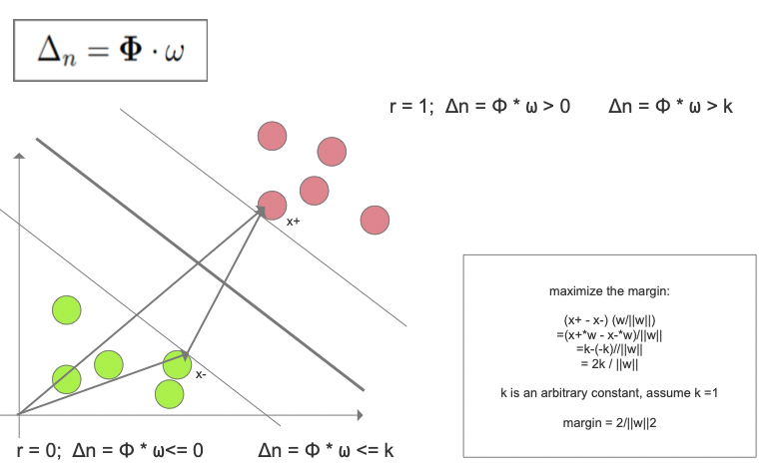
SVM Formulation

Slide 11
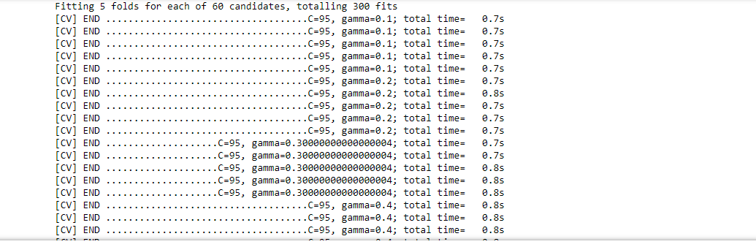
SVM Numerical Methods
Grid Search:

Slide 12
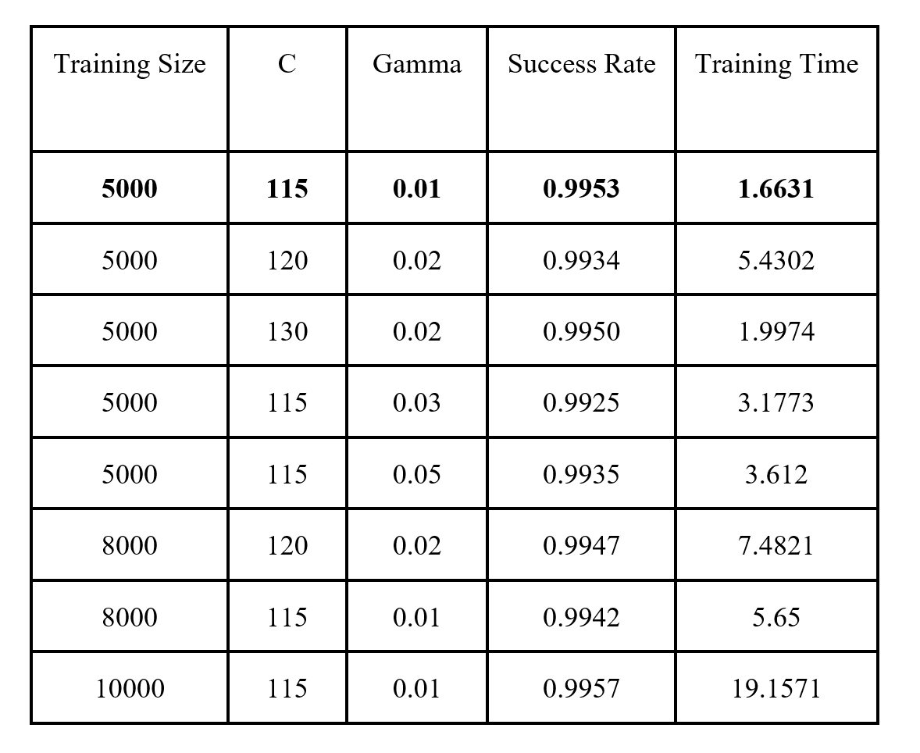
SVM Results

Slide 13
Neural Network (from scratch) Formulation
Single-layer neural network with single neuron
Input to the perceptron:
Sigmoid activation function as output layer

Slide 14
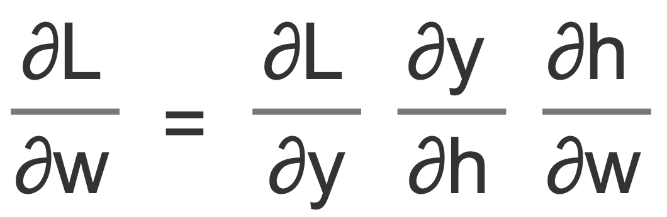
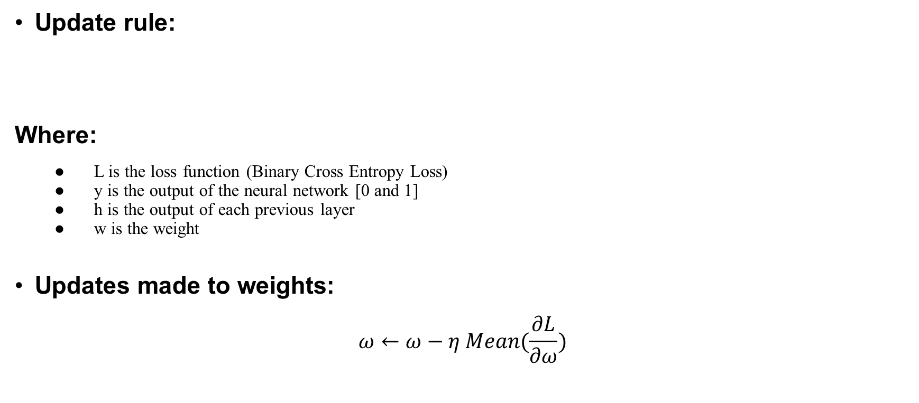
Neural Network (from scratch) Numerical Methods
Update rule:
Where:
L is the loss function (Binary Cross Entropy Loss)
y is the output of the neural network [0 and 1]
h is the output of each previous layer
w is the weight
Updates made to weights:
$$ω←ω−η Mean(\frac{∂L}{∂ω})$$

Slide 15
Neural Network (from scratch) Results
Training Size | Learning Rate | Epochs | Weight Initialization | Training Time | Success Rate
15000 | 400 | 15 | Uniform(-5, 5) | 6.089 | 0.9984
10000 | 100 | 15 | Uniform(0, 1) | 4.06 | 0.9962
10000 | 200 | 15 | Uniform(-1, 1) | 4.2010 | 0.9958
10000 | 400 | 15 | Uniform(-5, 5) | 3.9909 | 0.9956
10000 | 100 | 15 | Uniform(0, 1) | 3.9055 | 0.9955
5000 | 450 | 10 | Uniform(-3, -3) | 1.4167 | 0.9931

Slide 16
Overall Results & Conclusions:
Since this was a group project, models were evaluated on four different laptops
Final overall results were calculated on the same laptop using the following CPU: i7- 4.90 GHz (24MB Cache, 10 Cores, 16 threads)
FINAL RESULTS:
Best Overall: Neural Network (from Scratch) with 99.35% accuracy in 0.0156 seconds

